Slide 1
Gilbert Elementary PTO Meeting
August 20, 2024

Slide 2
Today’s Agenda:
. Meet the PTO Board
. Important Dates
. Year Goals
. Fundraising
. Volunteering
. Finance Update
. Upcoming Events

Slide 3
MEET THE PTO BOARD
Mariah Wallace - President
Neferteria Corner - Vice President
April Patten - Treasurer
Ellie Clements - Secretary
Monica Gittens - Volunteer Coordinator
Kristin Puckett - Special Programs Coordinator
Angie Crouch - Teacher Representative

Slide 4
Important Dates
Movie Night
September 20th @ GES @ 6:00 pm - 8:00 pm
Next PTO Meeting
September 23rd @ 6:00 pm
Spirit Night
September 26th @ Chick Fil A (all day)

Slide 5
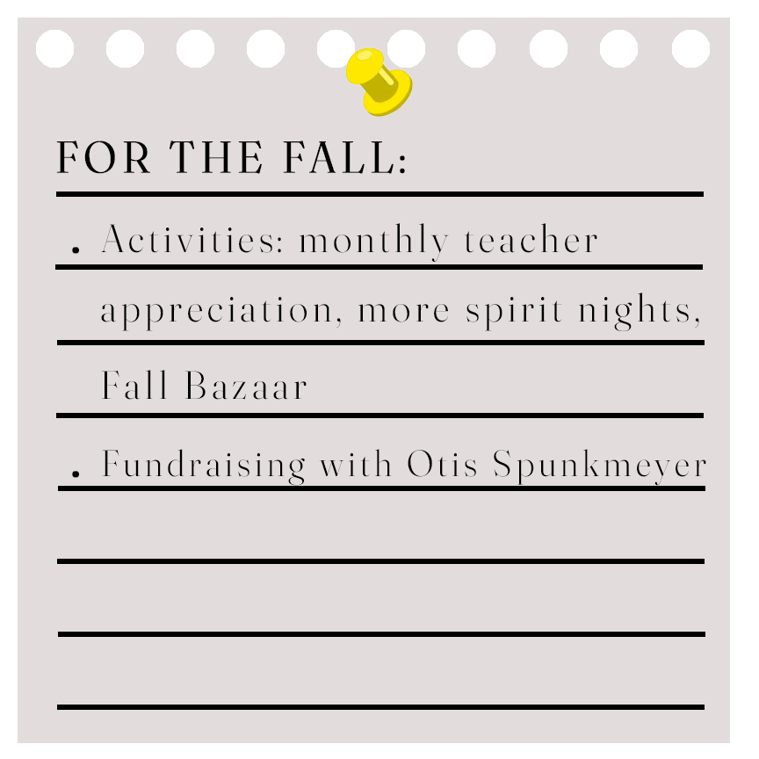
Year Goals

Slide 6
Fundraising
We are planning to partner with Cherrydale Fundraising in October to sell cookie dough! These contain 36 pre-portioned cookie dough trays and will be great for the upcoming holidays.

Slide 7
Volunteering
Dad’s On Duty
This is the 2nd year for Dad’s on Duty. We need more dads! If you’re interested in joining a great group of dads and be a positive role model to students, please contact Todd Wallace at
dadsonduty.ges@gmail.com
Volunteering
We are looking for volunteers to help with PTO events and school events. We will email all volunteers when events come up along with a sign-up link for any duties we need. If interested, please contact Monica Gittens at
monicagittens@gmail.com
Room Parents
Room Parents is a new program we are trying out this year. Room parents play a vital role in supporting teachers, organizing classroom events, and fostering a sense of community among parents and students. Please reach out to your child’s teacher to sign up and for more information, please email
scoutspto@gmail.com
*Please note that all volunteers need to fill out a volunteer form with Lexington District One. All volunteers must be able to pass a background check. Visit https://www.lexington1.net/lex1family/communitymembers/volunteer for more info.

Slide 8
Volunteer Orientation
Interested in volunteering but want to learn more? Join us on September 6, 2024 at 8:00 am at GES for Volunteer Orientation. We will be here to answer any questions and walk you through the steps of becoming a volunteer through the district. Light refreshments will be served. :)

Slide 9
Finances
Savings: $100.00
Checking: $9,903.55
Courtyard: $4,440.19

Slide 10
October:
. Costume Change Wars, Sonic Spirit Night, Breakfast with Buddies
November:
. Sonic Spirit Night, Fall Bazaar
December:
. Knead Pizza Spirit Day, Winter Workshop - Students can shop for the holidays

Slide 11
COMING SOON
We are in the process of creating a new Facebook page. Be on the lookout for our new page. Mr. Deyo will post the new link to Parent Square, and we will put a link up on the old Facebook page as well. :)

Slide 12
Thank you for joining us tonight! And thank you for supported GES and our wonderful PTO. We couldn’t do any of this without all of you.
If you have any questions or concerns, please don’t hesitate to reach out to us at scoutspto@gmail.com

